Slide 1


Signal Processing in the ProtoDUNE-SP LArTPC
Wenqiang Gu
Brookhaven National Laboratory
For the DUNE collaboration

Slide 2
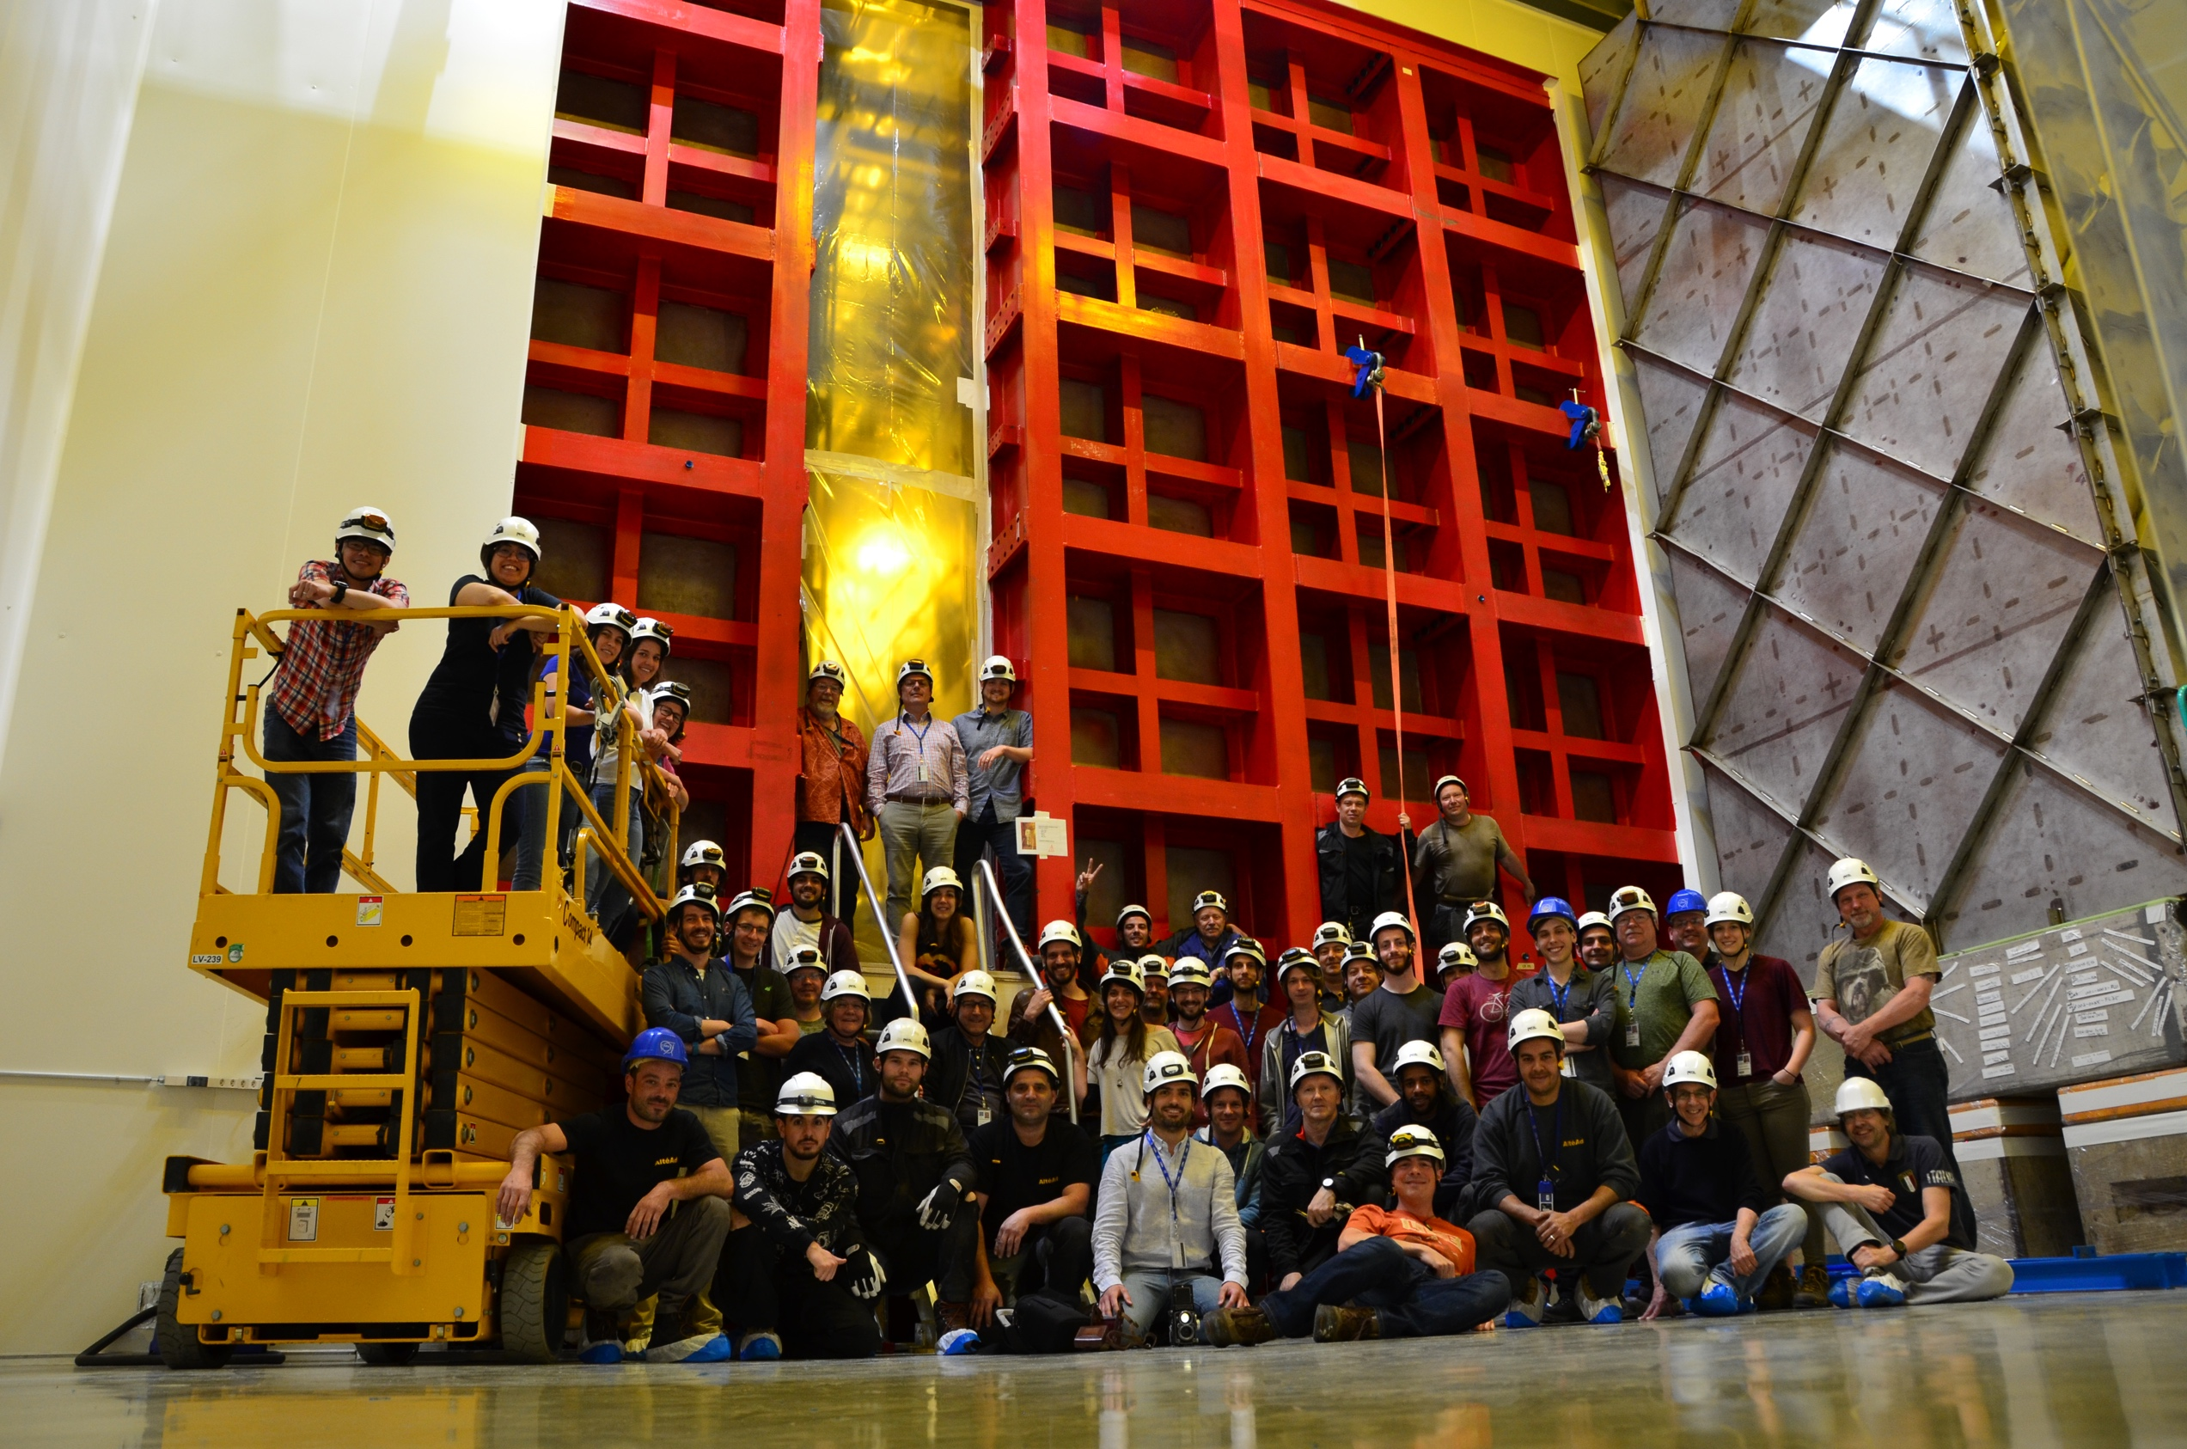
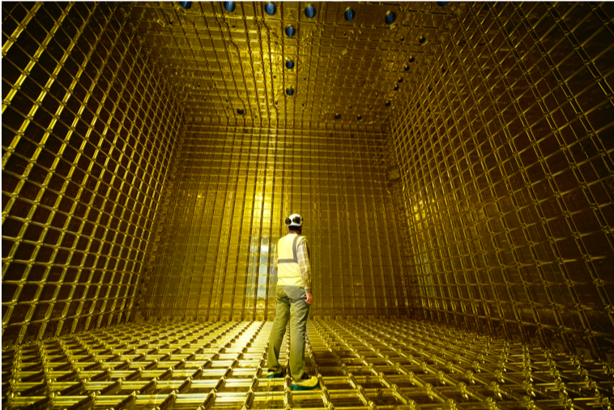
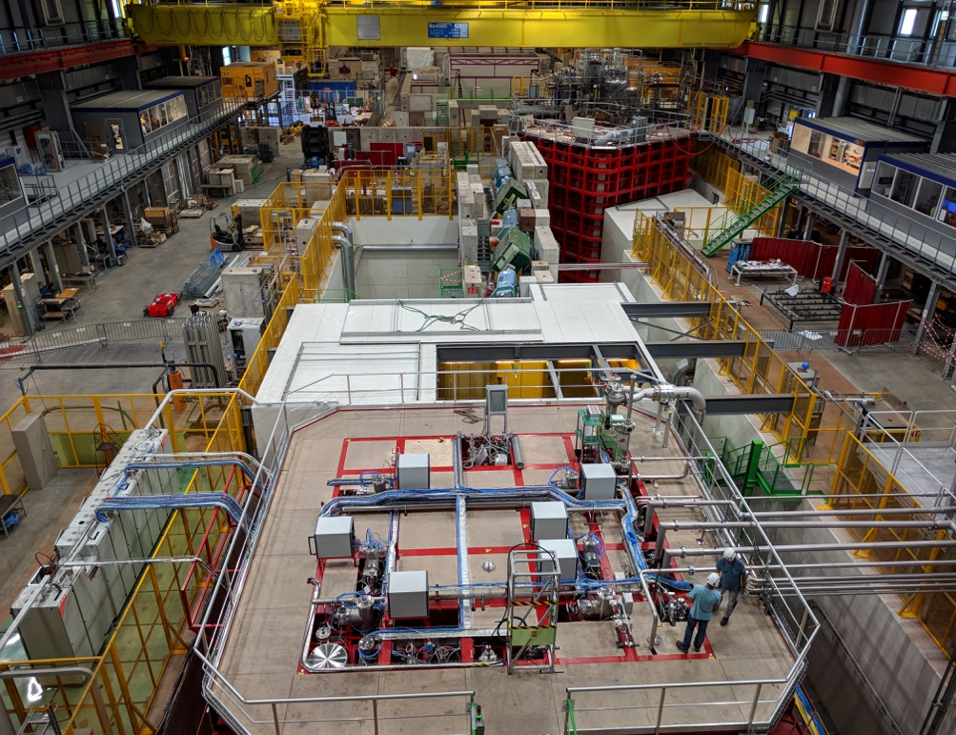
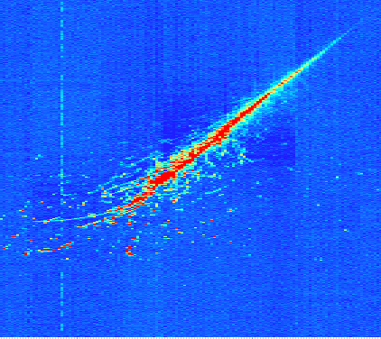
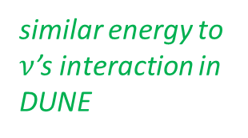
ProtoDUNE Single Phase (SP)
T12.00005, Hannah Elizabeth Rogers
Overview of ProtoDUNE and Initial Study of Space Charge
A 0.77-kt LArTPC at the CERN Neutrino Platform (NP)
World largest monolithic single-phase LArTPC
Prototypes DUNE far detector (FD) components design at 1: 1 scale
Started operation in late 2018
Exposed to cosmic & a dedicated charged particle beam (0.3 - 7 GeV)
similar energy to $ν$’s interaction in DUNE
E.M. shower

Slide 3
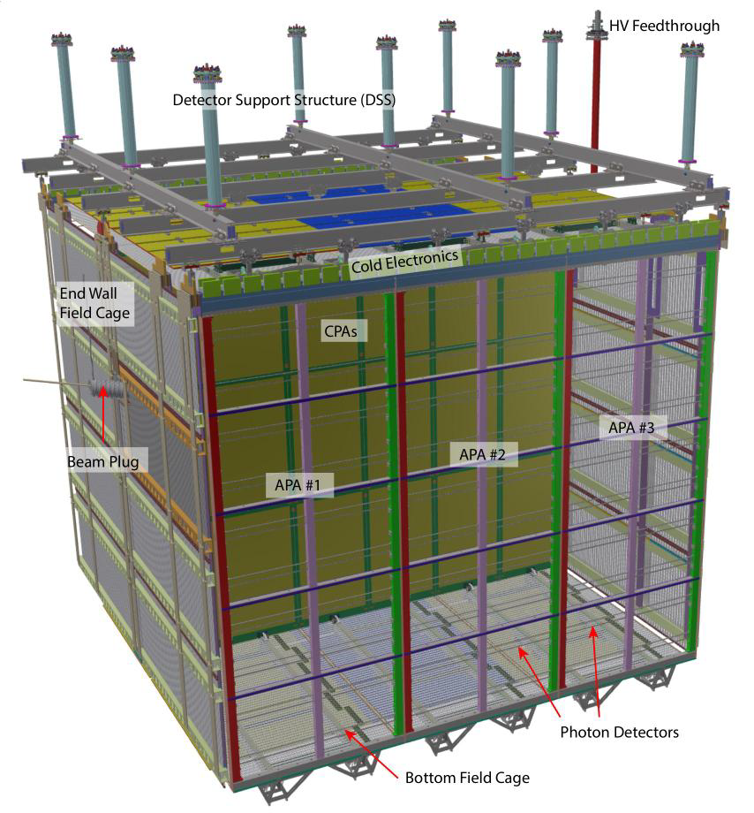
ProtoDUNE-SP Overview
6 Anode Plane Assemblies (APAs)
Total 15,360 TPC sense wires/channels with ~ 5mm pitch
99.74%: active channels
3 Cathode Plane Assemblies (CPA)
Resistive Kapton laminated on dielectric panels
180 kV nominal (2 x 3.6 m drift @ 500 V/cm)
Highest voltage in all LArTPCs to date
6m
7.2m
7m
60 Photon Detectors
Light collecting bars read out by SiPMs installed in the APA frame (10 detectors/APA)
3 distinct versions installed → testing solutions for DUNE
L17.00004, Bryan J Ramson
The Photon Detection System (PDS) at ProtoDUNE

Slide 4
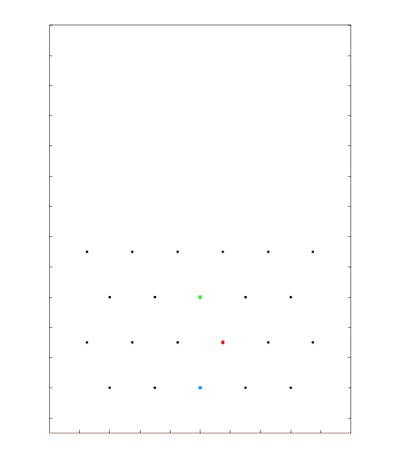
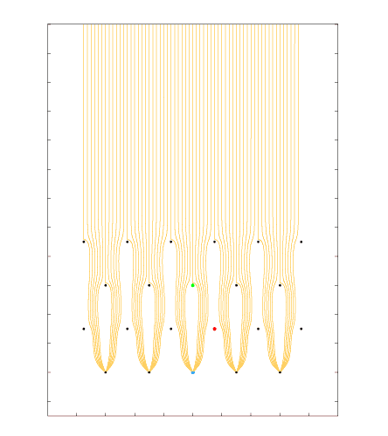
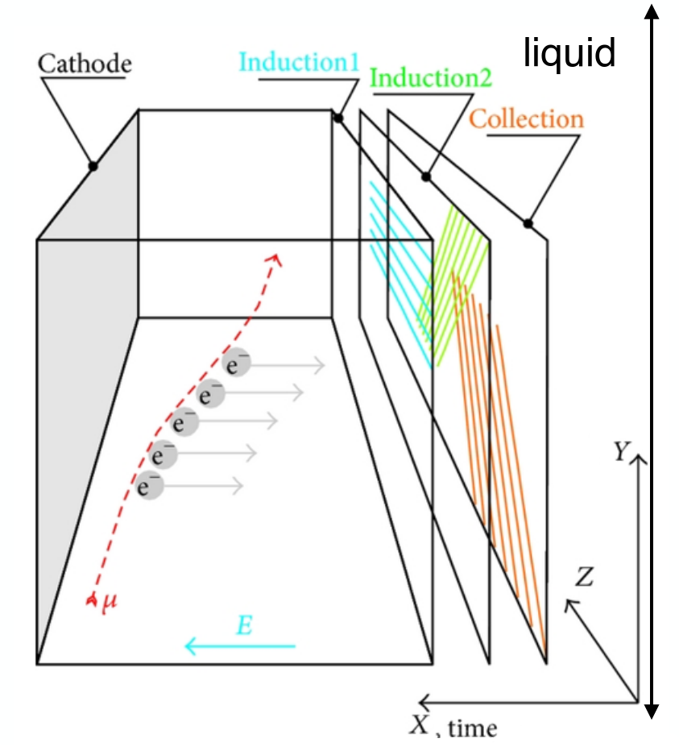
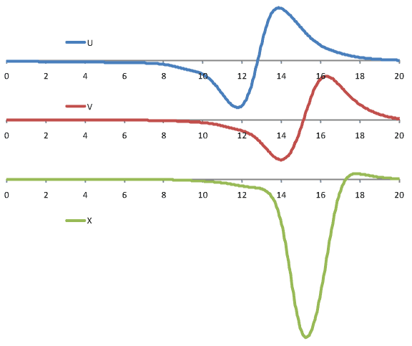
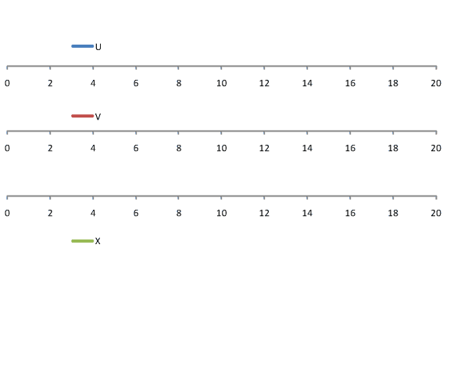
ProtoDUNE: How does it work?
Cartoon animation made by Bo Yu (BNL)
Ionization electrons drifted and induced current read out by three wire planes
Scintillation light collected by photon detection system
Providing event t₀

Slide 5
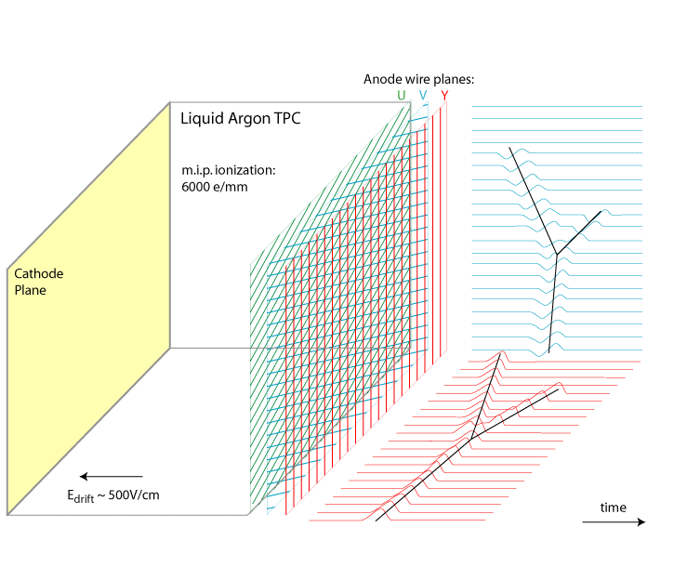
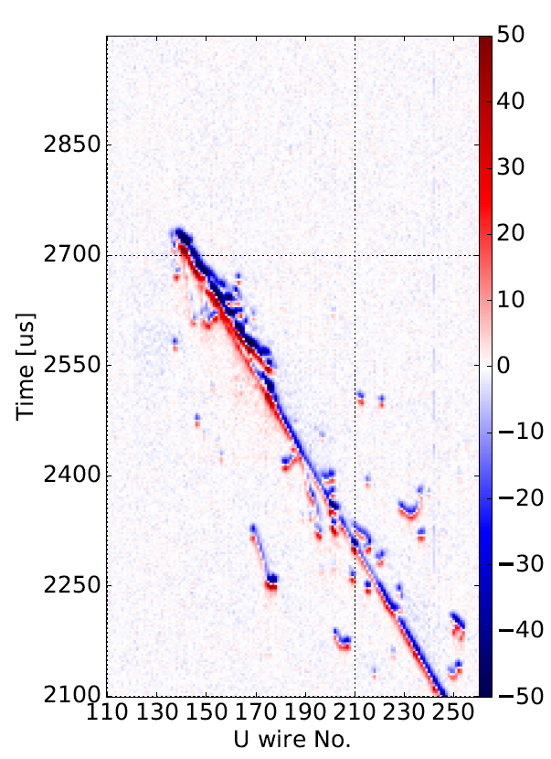
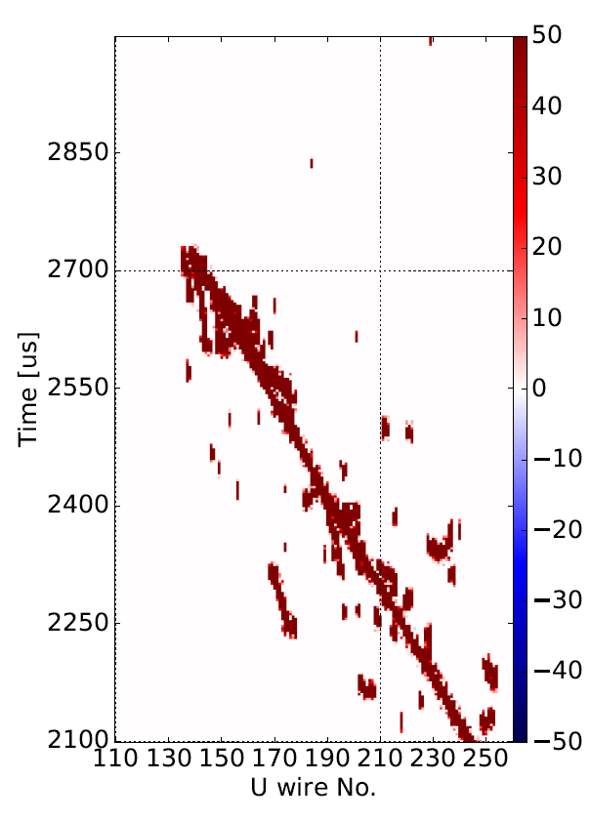
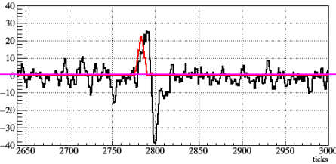
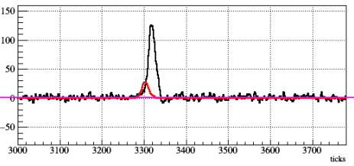
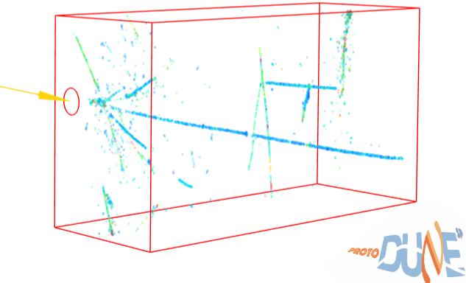
General Overview of LArTPC Reconstruction
LArTPC Signal Formation
Noise Filtering & Signal Processing
Induction
deconvolving
Main focus of today’s talk
collection
imaging
Kinematic Recon.
dE/dx & PID
2D Matching / 3D Recon.
1 GeV
Imaging, pattern recognition, clustering, etc.
Cosmic
fitting
Preliminary Result
T17.00007, Heng-Ye Liao
ProtoDUNE Proton Analysis

Slide 6
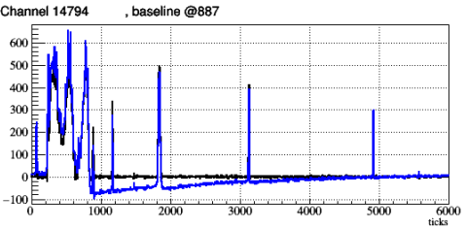
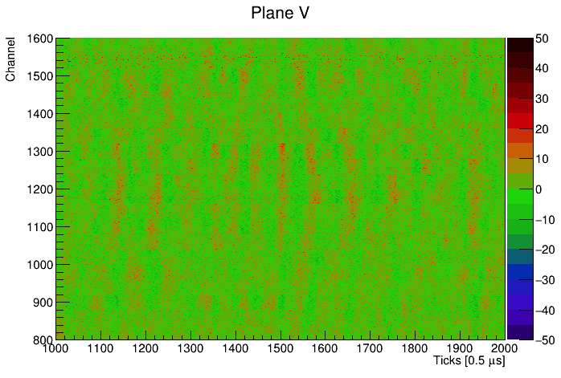
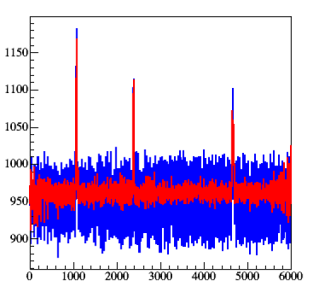
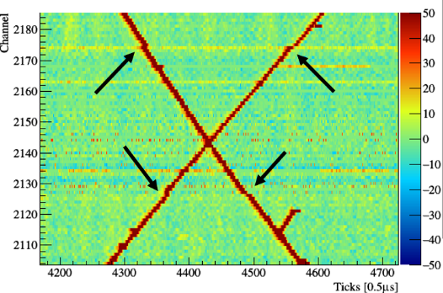
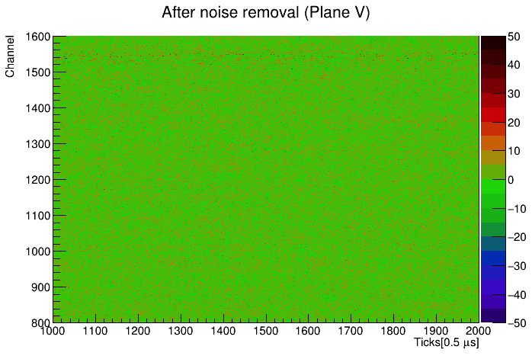
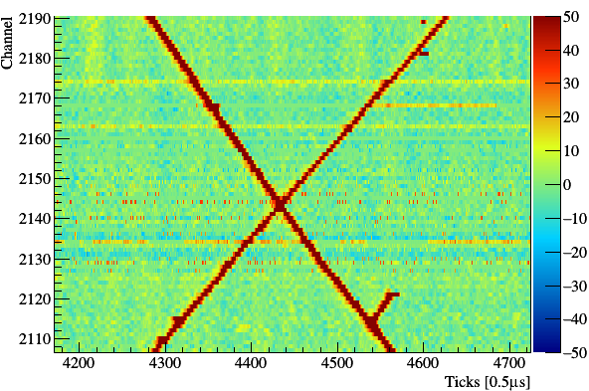
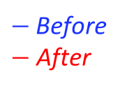
Noise Filtering
“RC” undershoot
After correction
Coherent noise
“50 kHz” collection plane noise
Channel
Time [0.5us]
$−$Before
$−$ After
clock issue in one of 120 FEMBs
After noise filtering
Channel
After correction
Time [0.5us]
Time [0.5us]
Filter out external noise properly
Correct additional hardware effect/distortion

Slide 7
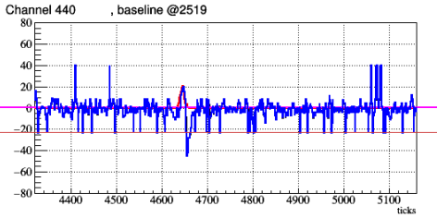
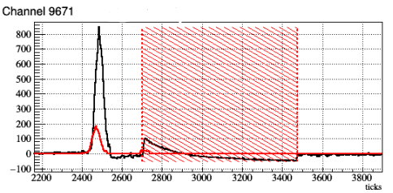
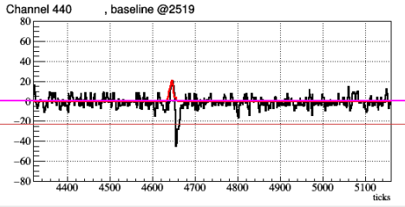
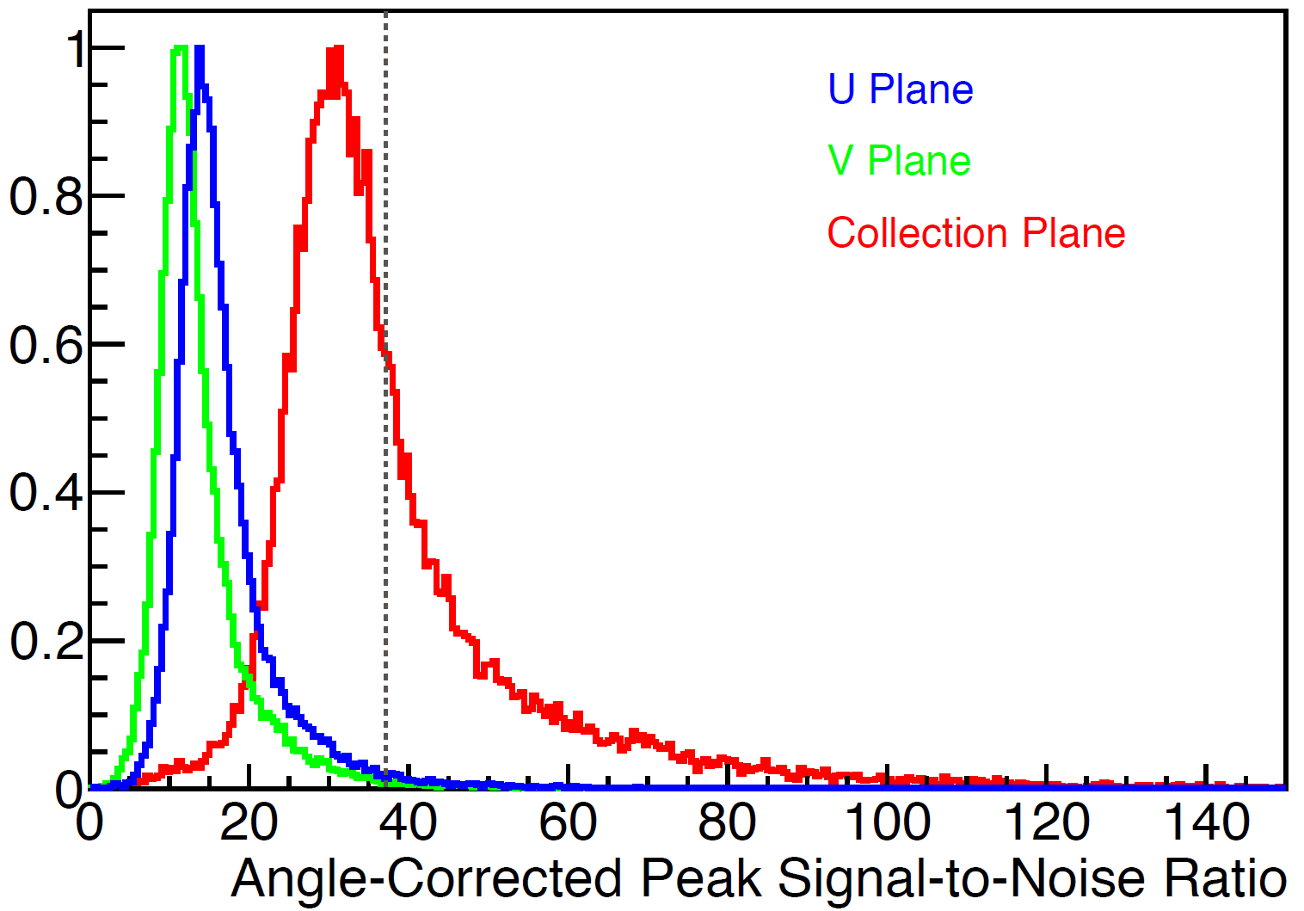
Noise Filtering (cont’)
< 1% of total channels
“ledge” waveform
evidence in ~3% of total channels
Sticky bits
Excluded from signal processing
After noise filtering
ENC of collection (X) plane 565 ± 60 e⁻
ENC of induction (V) plane 662 ± 56 e⁻
ENC of induction (U) plane 651 ± 54 e⁻
Fix some residual electronics issues
Overall performance of noise filtering is good

Slide 8
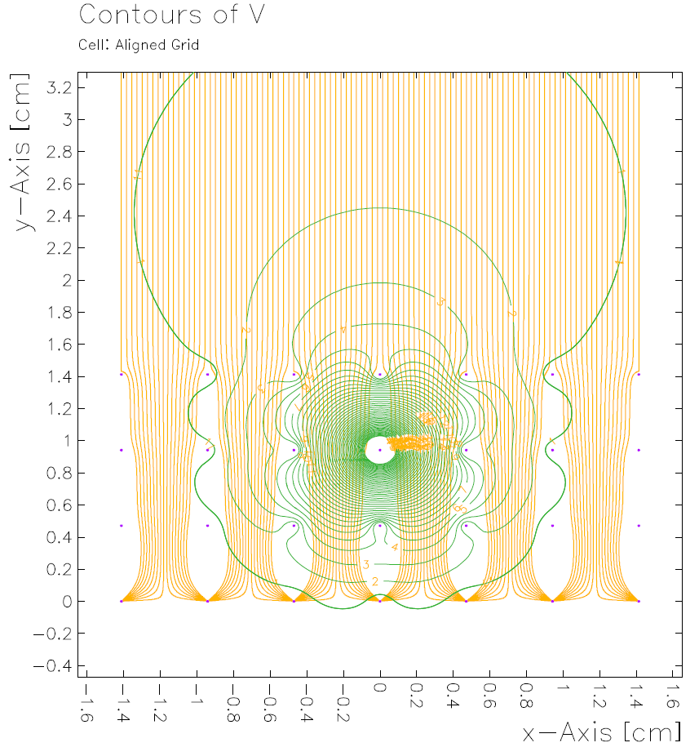
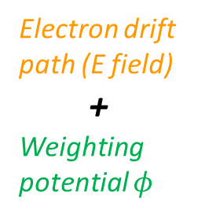

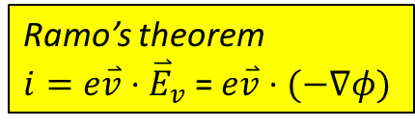
Field response: Garfield drift simulation
Garfield, a drift-chamber simulation program User’s Guide, Veenhof, R. (1993)
Ramo’s theorem
$i=e\overset{⃑}{v}⋅{\overset{⃑}{E}}_{v}$ = $e\overset{⃑}{v}⋅(−∇φ)$
Weighting potential $φ$
Wire pitch direction
Drift direction
Ionization electrons
Charge deposit
Electron drift path (E field)
+
Weighting potential $φ$
G
U
V
W
Induced current
Long-range induction

Slide 9
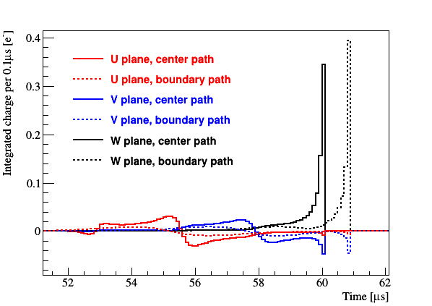
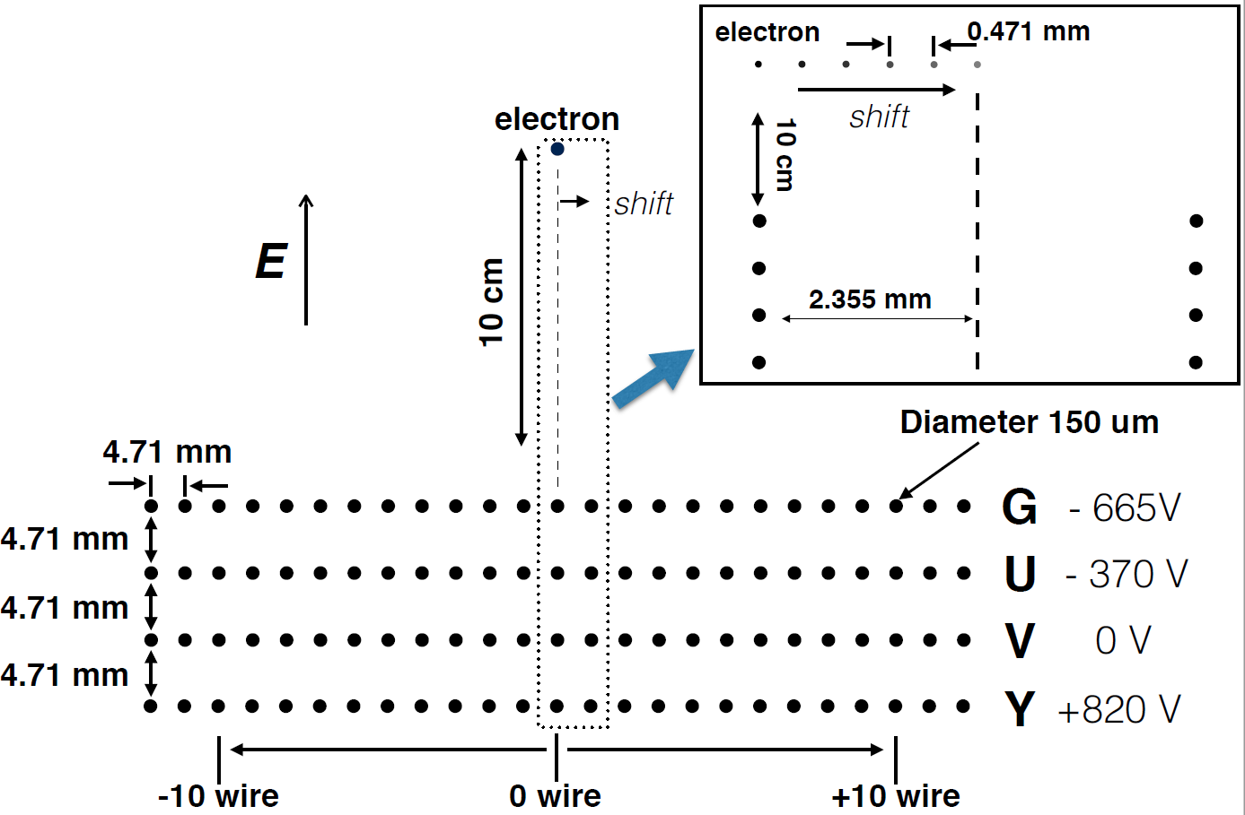
Field response: Garfield drift simulation
Ramo’s theorem
$i=e\overset{⃑}{v}⋅{\overset{⃑}{E}}_{v}$ = $e\overset{⃑}{v}⋅(−∇φ)$
W
Field response in the central wire

Slide 10
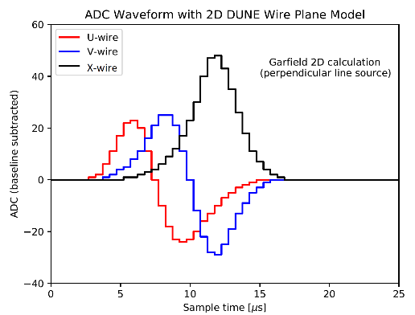
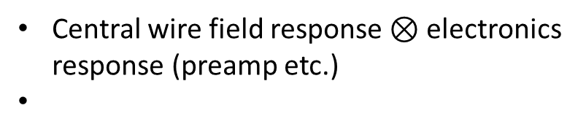
Field response: Garfield drift simulation
Ramo’s theorem
$i=e\overset{⃑}{v}⋅{\overset{⃑}{E}}_{v}$ = $e\overset{⃑}{v}⋅(−∇φ)$
Kernel in signal processing
W-wire
W
Central wire field response $⊗$ electronics response (preamp etc.)

Slide 11
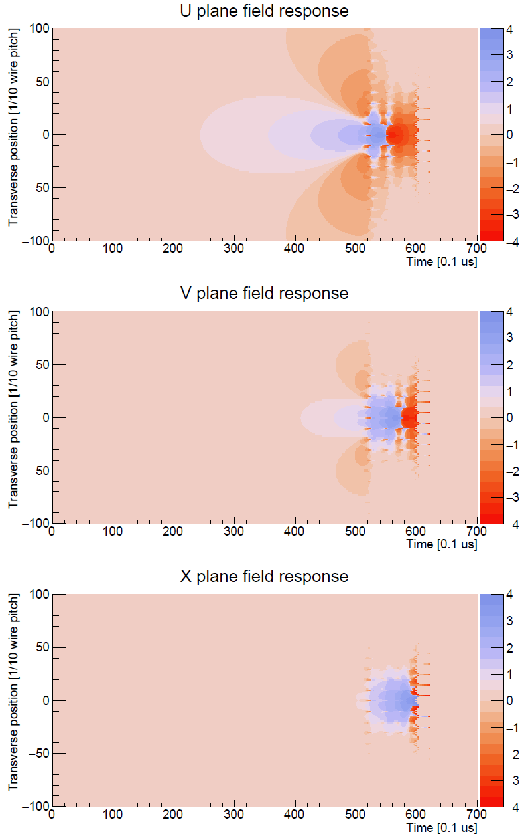
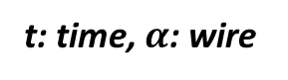
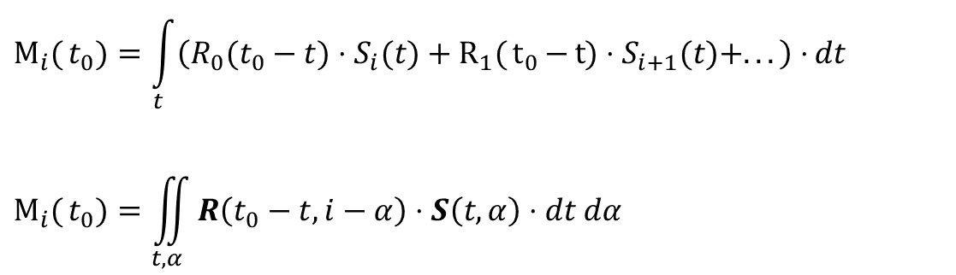
Long-range Induction: 2-D deconvolution
Ionization Electron Signal Processing in Single Phase LArTPCs I.
JINST 13 P07006 (2018)
It is natural to include the long-range induction effect in the deconvolution kernel
$$M_{i}{(}t_{0})=\int_{t}{\left(R_{0}(t_{0}−t)⋅S_{i}(t)+R_{1}{(}t_{0}{−}t{)}⋅S_{i+1}(t)+...\right)⋅}dt$$
$$M_{i}{(}t_{0})=\iint_{t, α}{R\left(t_{0}−t, i−α\right)⋅S\left(t, α\right)⋅dt dα}$$
t: time, $α$: wire
“2D” deconvolution (time + wire direction): M(t) -> S(t) through FFT
Equivalently, recover ionization charges from induced current from all wires

Slide 12
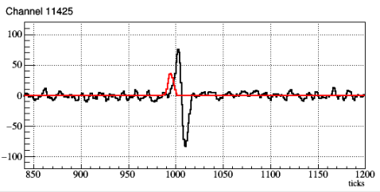
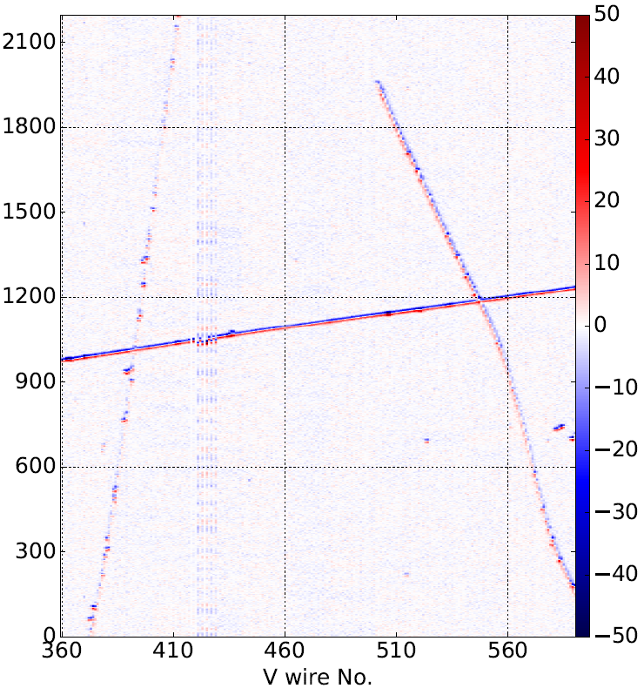
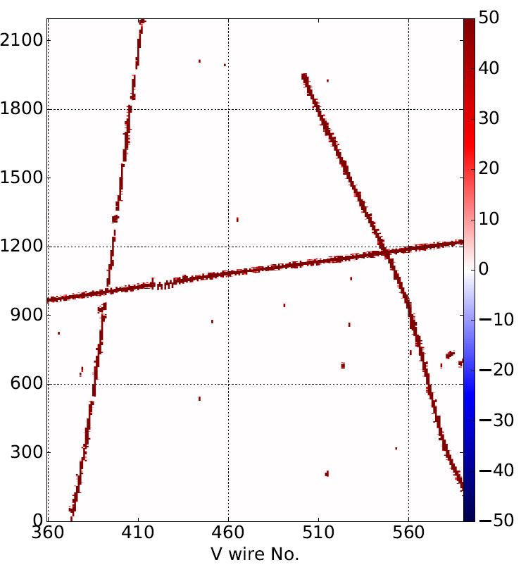
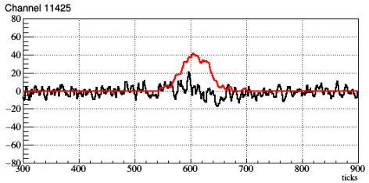
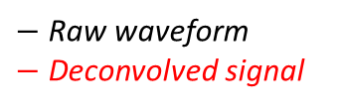
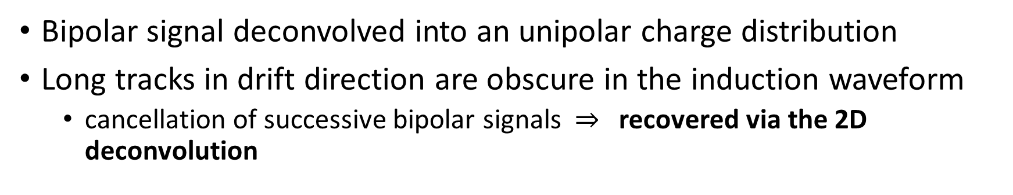
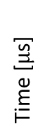
Signal Processing Example
wire 385
$−$ Raw waveform
$−$ Deconvolved signal
After Noise Filtering
After 2-D Deconvolution
wire 385
wire 385
Time [$μ$s]
wire 385
Topology dependence
Bipolar signal deconvolved into an unipolar charge distribution
Long tracks in drift direction are obscure in the induction waveform
cancellation of successive bipolar signals $⇒$ recovered via the 2D deconvolution

Slide 13
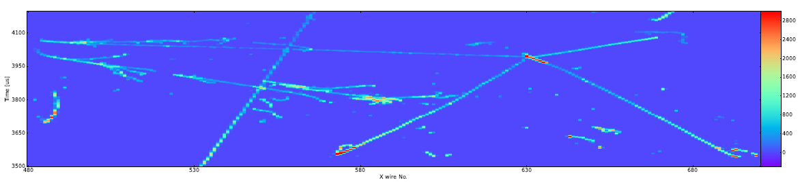
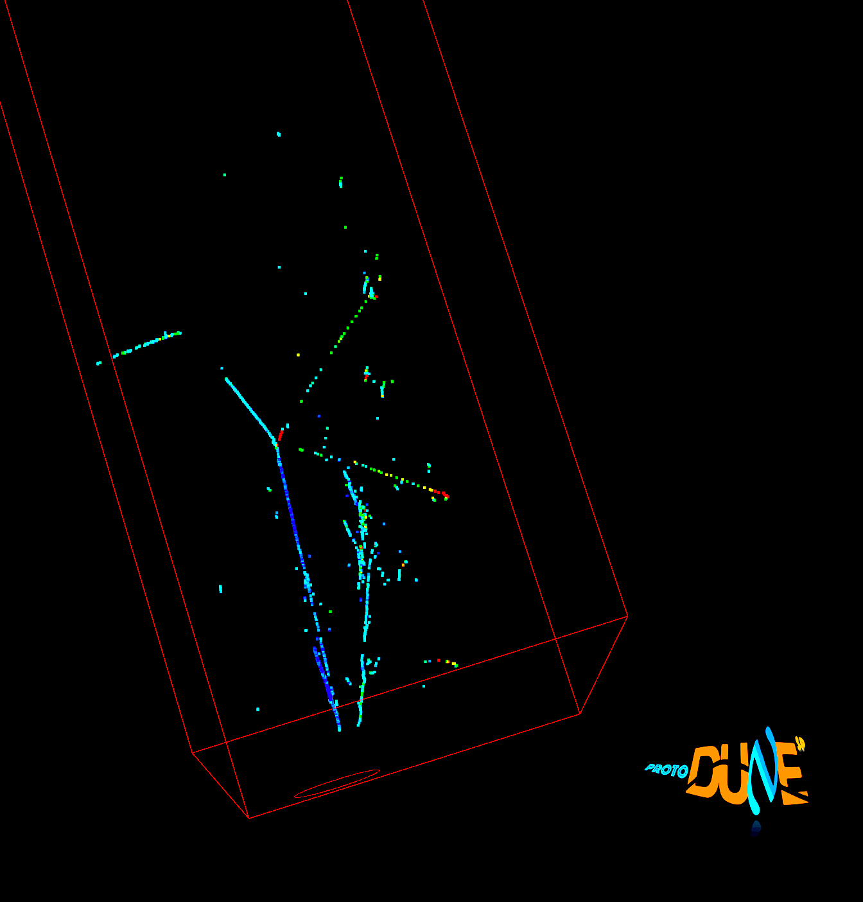
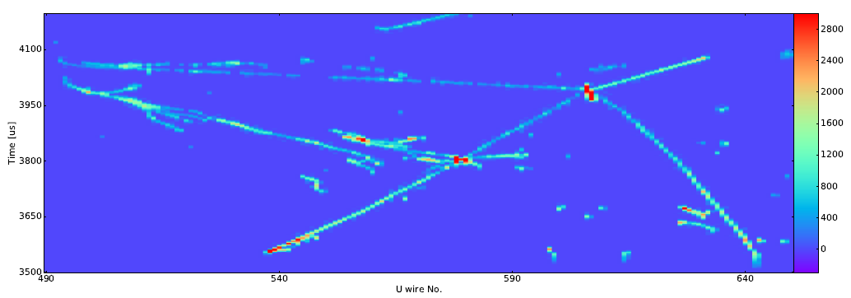
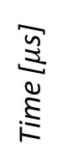

Track Reconstruction Example
Video | Online gallery by Chao Zhang (BNL)
Collection plane view
3D view
Time [$μ$s]
Three-plane “matching” solves the degeneracies inherent from wire readout ambiguity
Wire No.
Induction U plane view
2 EM showers and a pion interaction with 4 outgoing particles
Time [$μ$s]
Wire No.

Slide 14
Summary
ProtoDUNE-SP has been successfully operated since late 2018
Full-scale component design of the DUNE FD
The “2D” signal processing technique has been developed and successfully applied to the wire readouts
High-quality noise filtering
Field response kernel: Garfield electron drift simulation
Long-range induction handled in the deconvolution
High-performance signal processing is essential to the downstream event reconstruction and physics analysis

Slide 15
Backup Slides

Slide 16
Goals and challenges
ProtoDUNE-SP goals:
- Validate the prototype production and installation procedures - Confirmation of the design and suggest improvements
- Test-beam data to calibrate the detector response to different particle species and to measure argon-hadrons cross sections - Demonstration of the long term stability of the detector
Challenges (not exhaustive list):
- Size and modularity: all components full size for DUNE-SP
- Cryostat: warm structure, passive insulation, LNG technology
- Purity: non-evacuable volume, piston purge, purification, …
- HV: highest voltage TPC ever operated, resistive cathode
- Stability: light scintillation, HV, purity, cold electronics, …

Slide 17
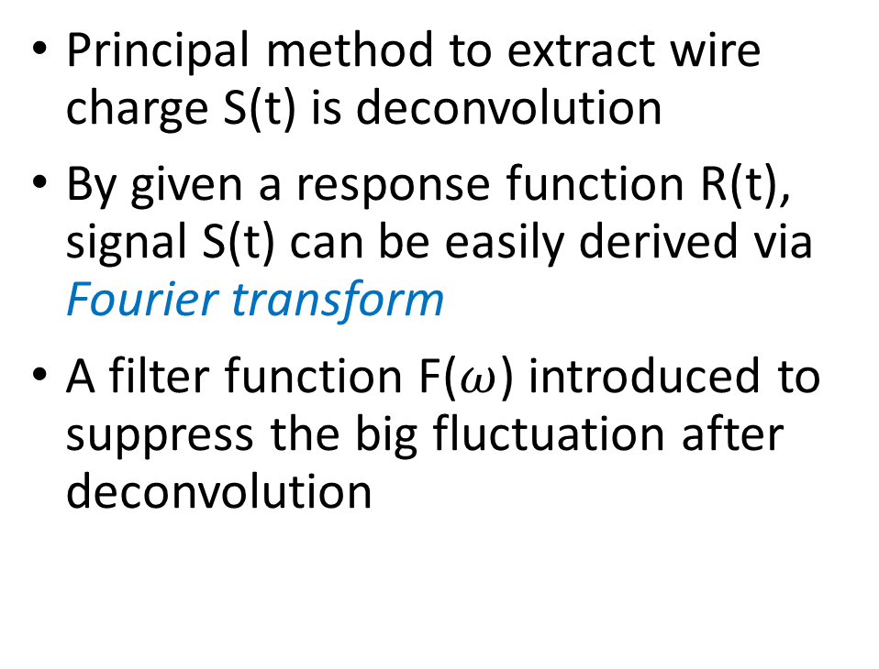
Basics of (1D) Signal Processing
Principal method to extract wire charge S(t) is deconvolution
By given a response function R(t), signal S(t) can be easily derived via Fourier transform
A filter function F($ω$) introduced to suppress the big fluctuation after deconvolution
Fourier transform
Deconvolution + Filter
Inverse Fourier transform
Liquid Argon TPC Signal Formation, Signal Processing and Hit Reconstruction
Bruce Baller, JINST 12 (2017) no.07, P07010

Slide 18



02/10/2018:
First event seen from beam!
(1 GeV electron)

Slide 19

Beam halo (high energy) muon with bremsstrahlung initiated E.M. shower
Collection plane view

Slide 20




Collection plane view
3D view
Induction U plane view
Induction V plane view

Slide 21

A BNL contribution to ProtoDUNE SP: Cold Readout Electronics

Slide 22



Integrated LAr-TPC Readout
Feedthrough
Each APA is isolated inside the cryostat and only connected to the cryostat through the CE at its own CE flange.
cryostat
Warm Interface Electronics: from CE to DAQ with shielding and local real-time diagnostics.
APA

